Slide 1
Chapter 9
How to use Flexible Box Layout for Responsive Web Design

Slide 2
Objectives
Applied
Use Flexible Box Layout to lay out simple web pages or components within web pages, including the layouts for mobile devices.
Knowledge
In general terms, describe the use of Flexible Box Layout.
Describe these terms as they apply to Flexible Box Layout: flexbox, flex item, main axis, cross axis, and flex direction.
Explain how the flex direction affects the way these alignment properties work: justify-content and align-items.

Slide 3
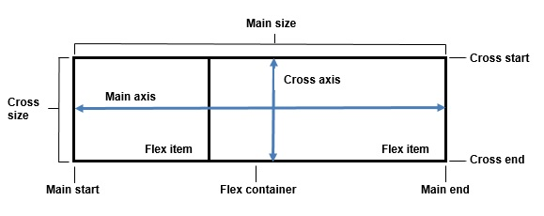
The flexible box layout

Slide 4
A navigation menu created using flexbox

Slide 5
The HTML and CSS for a navigation menu
The HTML
<nav>
<ul>
<li><a href="index.html">Home</a></li>
<li><a href="speakers.html">Speakers</a></li>
<li><a href="tickets.html">Get Tickets</a></li>
<li><a href="member.html">Become a Member</a>
</li>
<li><a href="aboutus.html">About Us</a></li>
</ul>
</nav>
CSS that displays the menu vertically
ul {
display: flex;
flex-direction: column; list-style-type: none;
padding: 0;
margin: 0;
}

Slide 6
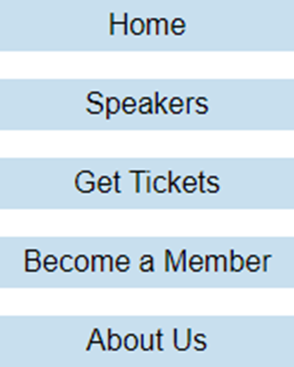
The layout of the navigation menu

Slide 7
The CSS for a navigation menu with equal spacing between flex items
ul {
display: flex;
justify-content: space-between;
list-style-type: none;
background-color: #C8DFEE; }
li {
background: #6FABCF;
padding: 15px;
text-align: center; }
a {
text-decoration: none;
color: #000; }

Slide 8
The justify-content property for flex boxes
Justify-content set to space-between
Justify-content set to space-around
Justify-content set to space-evenly
Justify-content set to flex-end

Slide 9
The CSS for a navigation menu that’s centered vertically in a container
ul {
display: flex;
align-items: center;
list-style-type: none;
background: silver;
height: 90px; }
#home { align-self: flex-start; }

Slide 10
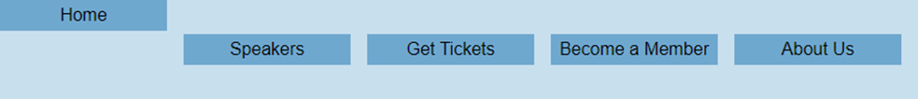
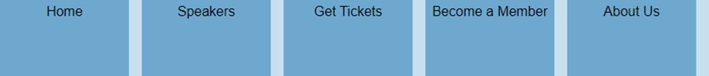
The align-items property for flex boxes
Align items is set to center
Align-items is set to stretch

Slide 11
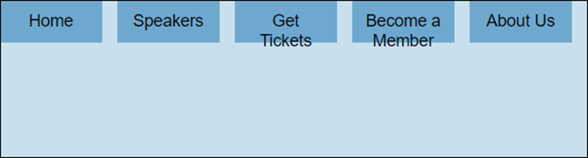
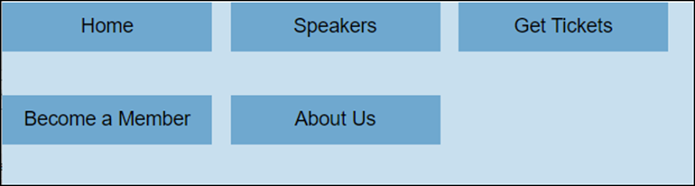
A menu with no wrapping
A menu with wrapping and default alignment
ul { flex-wrap: wrap; }

Slide 12
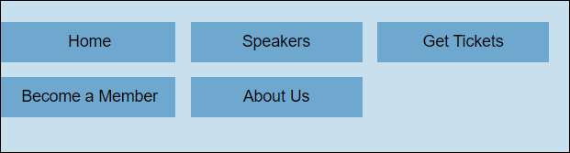
A menu with wrapping and center alignment
ul { flex-wrap: wrap; align-content: center; }

Slide 13
The HTML for a simple page layout
<main>
<nav>Navigation</nav>
<section>Content</section>
<aside>Sidebar</aside>
</main>

Slide 14
CSS that uses the flex-basis property
main { display: flex; }
nav, aside { flex-basis: 25%; }
section { flex-basis: 50%; }
The layout at 400 pixels wide
The layout at 800 pixels wide

Slide 15
CSS for the flex-basis and flex-grow properties
nav, aside {
flex-basis: 100px;
flex-grow: 1; }
section {
flex-basis: 200px;
flex-grow: 3; }
The layout at 400 pixels wide
The layout at 800 pixels wide

Slide 16
CSS for the flex-basis and flex-shrink properties
nav, section, aside { flex-basis: 250px; }
nav { flex-shrink: 0; }
section, aside { flex-shrink: 1; }
The layout at 750 pixels wide
The layout at 500 pixels wide

Slide 17

CSS that uses the flex property
nav, aside { flex: 1 1 100px; }
section { flex: 2 2 300px; }
The layout at 500 pixels wide
The layout at 750 pixels wide
The layout at 250 pixels wide

Slide 18
The HTML for a page
<body>
<header><h3>Header</h3></header>
<main>
<aside><h3>Sidebar</h3></aside>
<section><h3>Section</h3></section>
</main>
<footer><h3>Footer</h3></footer>
</body>
A media query that changes the flex direction and reorders flex items
@media screen and (max-width: 760px) {
main { flex-direction: column; }
section { order: 1; }
aside { order: 2; }
}

Slide 19
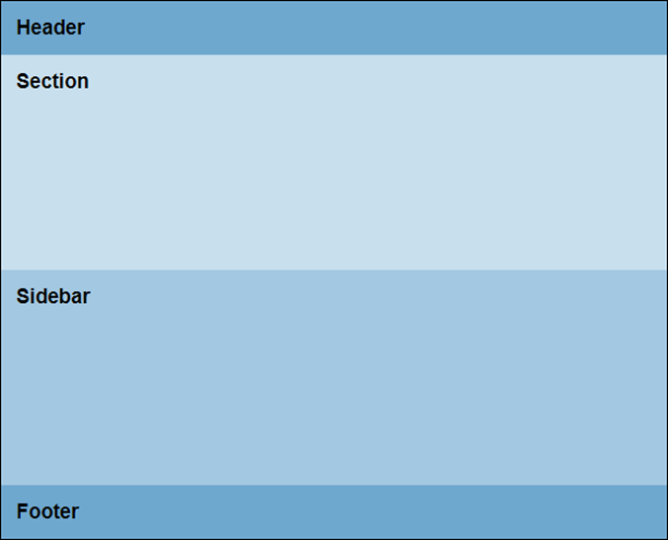
The page at a narrow width with the section and aside reordered

Slide 20
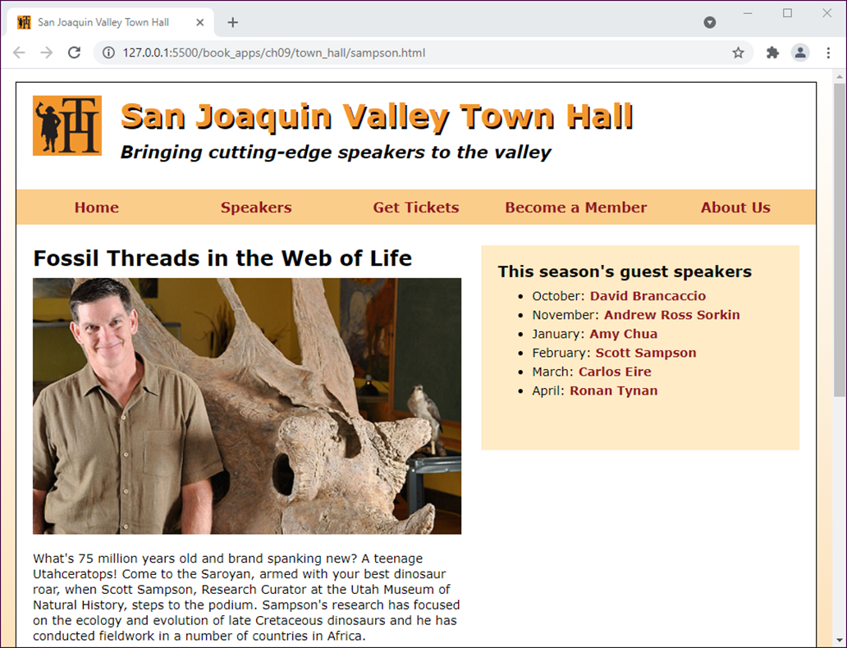
A speaker page in desktop layout

Slide 21
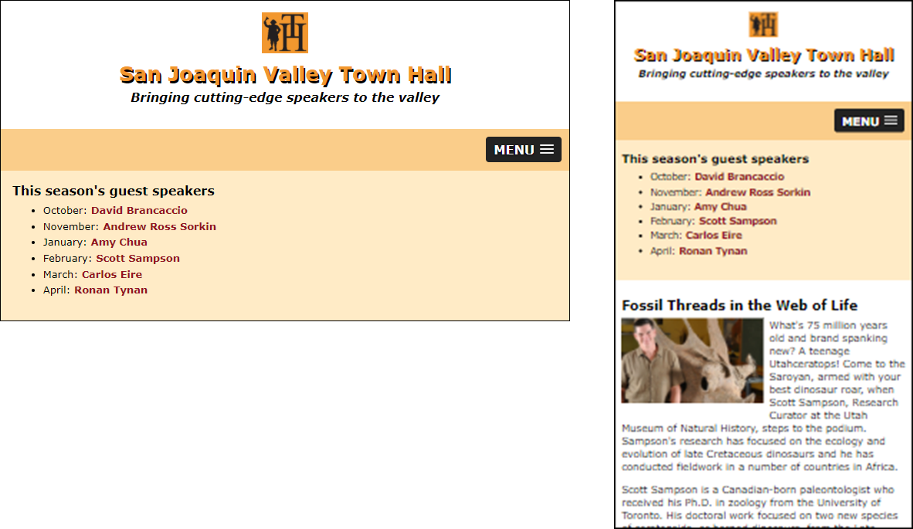
A speaker page in mobile layout

Slide 22
The HTML for the structure of the page
<body>
<header>...</header>
<nav id="mobile_menu"></nav>
<nav id="nav_menu">
<ul>
<li><a href="index.html">Home</a></li>
...
</ul>
</nav>
<main>
<article>...</article>
<aside>
<nav>...
<ul>...</ul>
</nav>
</aside>
</main>
<footer>...</footer>
</body>

Slide 23
The CSS for larger screens (part 1)
* the styles for the image in the header
header img { /* image isn't scaled */
float: left;
margin-left: 2.0202%;
}
* the styles for the navigation menu
#nav_menu ul {
display: flex;
flex-basis: 100%;
justify-content: space-around;
list-style-type: none;
margin: 0;
padding: 0;
}
#nav_menu ul li {
flex-basis: 20%;
}

Slide 24
The CSS for larger screens (part 2)
/* the styles for the main element */
main {
display: flex;
}
/* the styles for the article */
article {
flex-basis: 60%;
margin: 2.0202% 0 2.0202%;
padding: 1.5em 2.52525% 0 0;
}
article img {
margin-bottom: 1em;
max-width: 100%;
}

Slide 25
The CSS for larger screens (part 3)
/* the styles for the sidebar */
aside {
flex-basis: 40%;
max-height: 200px;
min-height: 180px;
padding: 2.0202%;
background-color: #ffebc6;
margin: 1.5em 2.0202% 0 0;
}

Slide 26
The media query that changes the display to a single column
@media only screen and (max-width: 796px) {
header {
display: flex;
flex-direction: column;
align-items: center; }
header h2, header h3, header img {
margin-left: 0; }
header img {
float: none;
margin-left: 0;
flex-basis: 60px; }
main {
flex-direction: column; }
article {
order: 2; }
aside {
order: 1;
margin: 0; }
}

Slide 27
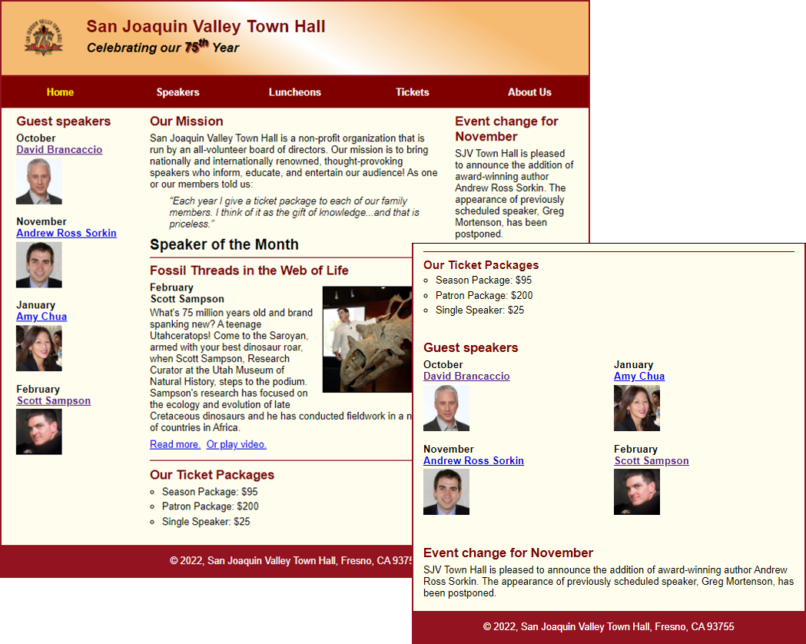
Short 9-1 Use flexbox to add a third column to the Town Hall home page

